Slide 1
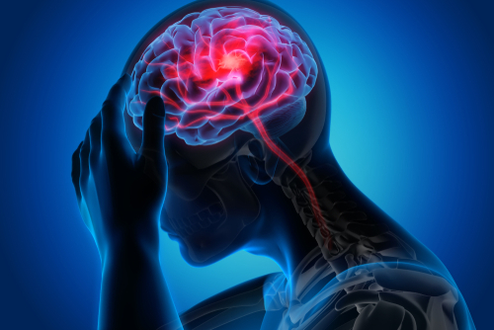
Prediction of occurrence of Brain Stroke

Slide 2




Introduction
There are 13.7 million new strokes of all types each year.
Globally every fourth person aged over 25 years will suffer a stroke in their lifetime.
Brain Stroke is the second leading cause of death worldwide. 5.5 million people die of stroke annually.
Stroke is a leading cause of serious, Longterm disability. Every year, over 116 million years of healthy life is lost due to stroke.

Slide 3

Problem Statement
How can we predict the occurrence of brain stroke for a person accurately to reduce the deaths ??

Slide 4











Dataset
Hypertension
Heart Disease
Ever married
Residence Type
The dataset of Brain Stroke is imported from kaggle.
In our dataset there are about 4981 instances.
Here the dependent variable is stroke.
In this dataset, as our dependent variable is categorical, and has two unique values we use binary classification models.
Work type
Average Glucose level
Smoking
BMI
Age
Gender
Stroke (Dependent variable)
Independent Variables

Slide 5
Azure ML Steps
Import and Preprocess the data
Label Encoding
Split Data
Train data with different algorithms
Test Data
Evaluate Model

Slide 6
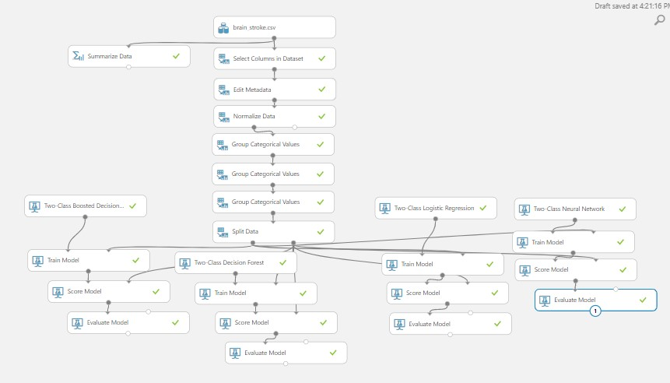
Azure ML Model

Slide 7
Confusion Matrix
True Positive
(TP)
False Negative
(FN)
Person had a stroke but the model predicted that the person wont have a stroke.
Person had a stroke and the model also predicted that the person would have a stroke.
Person didn't have a stroke but the model predicted that the person would have a stroke.
Person did not have a stroke, the model also predicted that the person wont have a stroke.
False Positive
(FP)
True Negative
(TN)

Slide 8
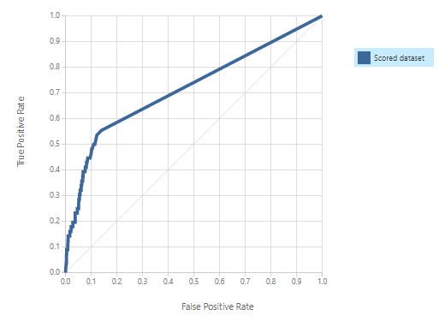
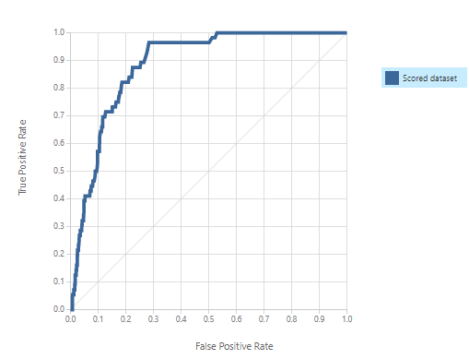
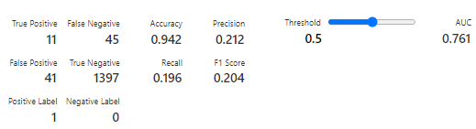
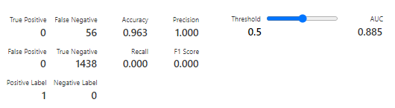
Two class Boosted Decision Tree model
Two class Logistic Regression model

Slide 9
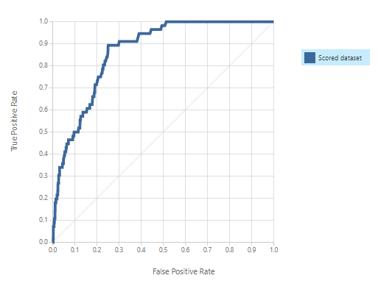
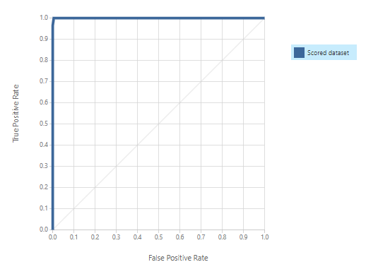
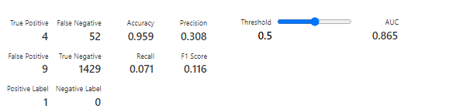
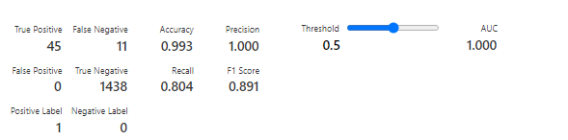
Two class Neural Network model
Two class Decision Forest model

Slide 10
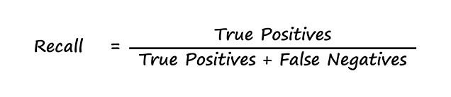
In our case, false negative i.e., person had a stroke but the model predicted that the person didn't have a stroke has a lot of impact.
Finding the Best Evaluation Metric
In such cases recall is considered the best evaluation metric as we need to have less false negatives for our data .

Slide 11
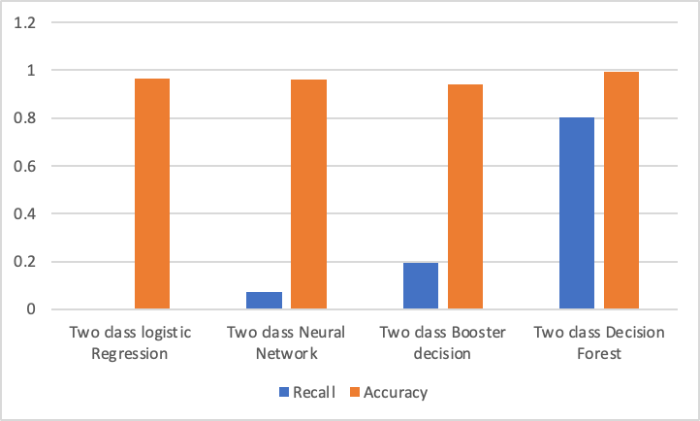
Evaluation for Different Models

Slide 12
Two Class Decision Forest
This decision forest algorithm is an ensemble learning method intended for classification tasks. Ensemble methods are based on the general principle that rather than relying on a single model, you can get better results and a more generalized model by creating multiple related models and combining them in some way.
By observing the recall value of all the different models two class decision forest has the best recall value. Hence it is considered the best evaluation model among all the used models for predicting the brain stroke.

Slide 13

Conclusion
Early prediction will also help in reducing the severity of the disease and avoid socio economic burden for the families.
If the risk of occurrence of Brain stroke is predicted earlier, a person can take precautionary measures prior the attack.

Slide 14

Team Avengers
Sowmya Lakshmi Putta
Aiswarya Reddy Rangam
Varshini Poreddy
Ashwin Kumar Reddy Guduru
Sri Sai Teja Balusu

